Slide 1





Understory Growth Dynamics following High Severity Burn in a Mixed-Conifer Forest
Daniel Wilcox, Space Grant Intern
Dr. Shirley A. Papuga, Faculty Advisor
Dr. Tyson Swetnam, Mentor
School of Natural Resources and the Environment
University of Arizona
23nd Annual Arizona Space Grant Consortium Symposium
April 12th, 2014

Slide 2
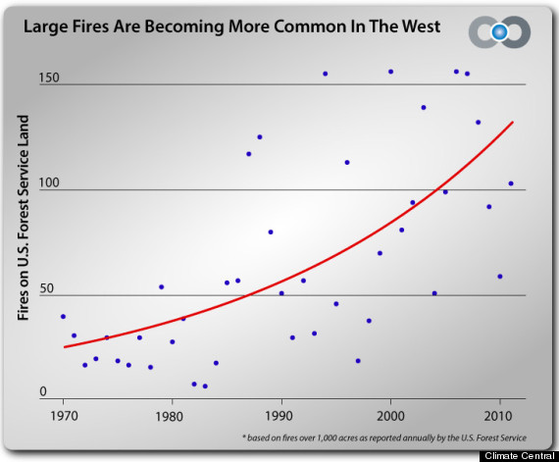
Big Picture
In recent years, rampant wildfire in forests has become increasingly prevalent
Forests provide important ecosystem services, such as carbon uptake and regulation of both water and erosion.
Therefore understanding the dynamics of how they recover will become increasingly important.
Credit: www.huffingtonpost.com

Slide 3
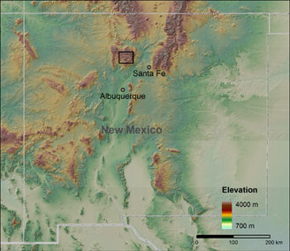
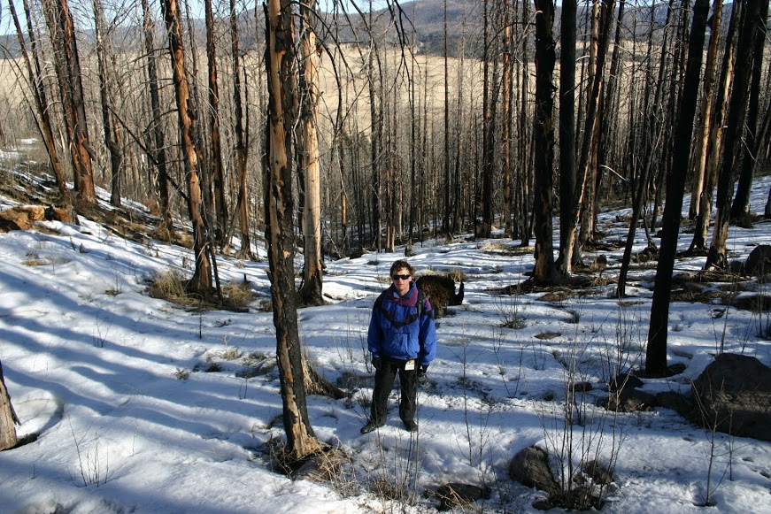
Study Area
Spring 2014
Map Credit: Matej Durcik
Two adjacent mixed-conifer watersheds impacted by the 2011 Las Conchas Fire, Jemez Mountains, NM
Elevation: 2664 m – 2934 m
Annual Precipitation: 670 mm

Slide 4
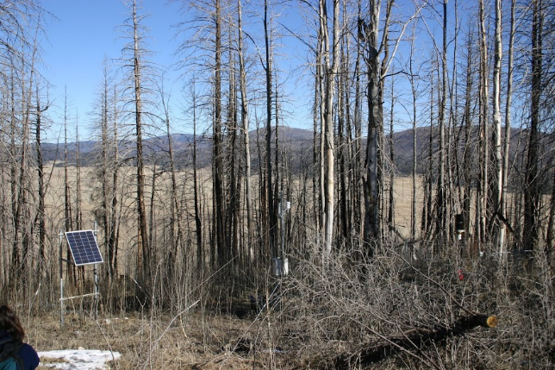
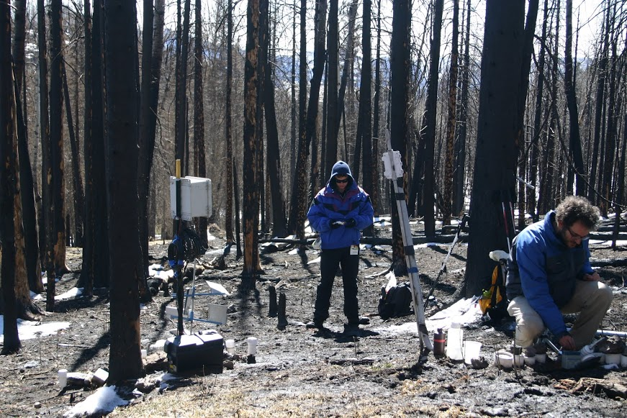
Methods
Meteorological stations at the top and bottom of the watershed measured ecohydrological variables such as precipitation and air temperature every 30 minutes
Sensors in soil pits took measurements of soil temperature and soil moisture at three different depths every 10 minutes

Slide 5
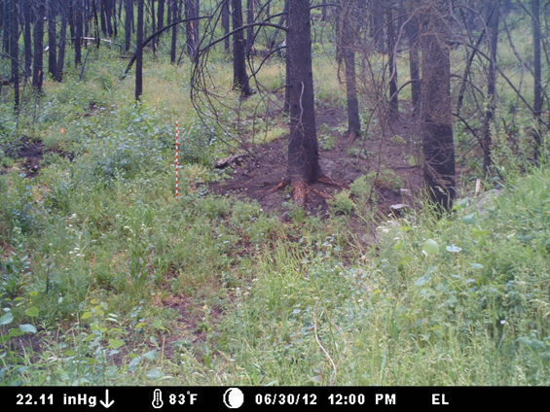
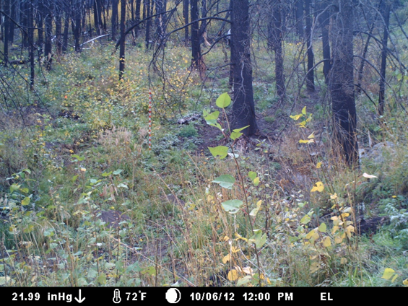

Methods
10 “phenocams” were installed at different elevations and aspects (slope directions)
cameras took hourly images for one year post-fire
Cameras allowed observation of vegetation at any desired time throughout the year
From the images, a total greenness index was calculated based on the RGB values of the pixels:
Early Season (June)
Aspen
Late Season (Oct)
$$I_{g}=2×green −red−blue$$
http://youtu.be/iTe5oj8rqHA
(Richardson et al 2007)
Notes:
Greenness index; a measure of the greenness in a photo based on pixel RGB values. Greenness of a photo is taken as an average of the greenness values of every pixel in the photograph.

Slide 6
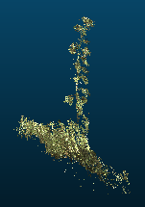
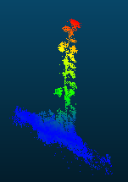
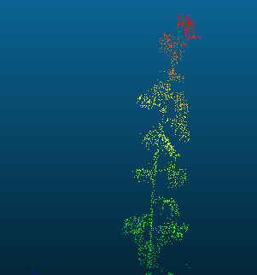
Methods
4 Terrestrial LiDAR Scans
  LiDAR: Sweep a laser over an area to get a 2D mesh of distances. Combining multiple scans gives a 3D point cloud.
Point clouds were visualized and analyzed using CloudCompare software.
Comparing two scans at different times allows visualization of all the changes in the landscape
An aspen
seedling in
the point
cloud
Data collected by Caitlin Orem, Jon Pelletier (UA Geology).

Slide 7
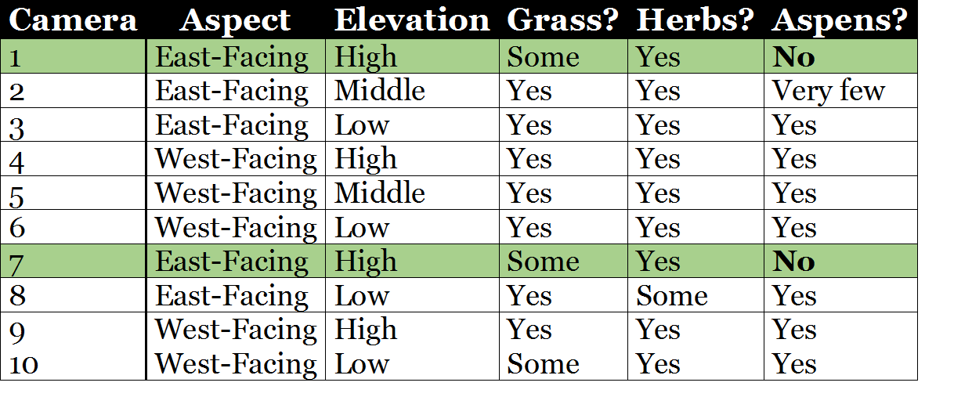
Results
The cameras show that vegetation understory growth was not uniform across the watershed.
Aspens were seen in all sites except the two higher-elevation east-facing ones.

Slide 8
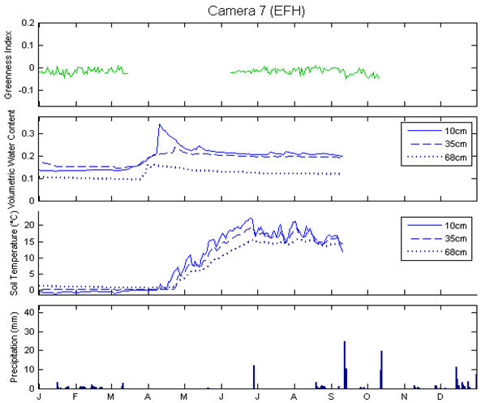
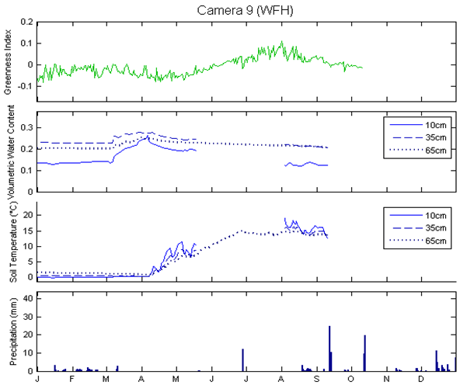
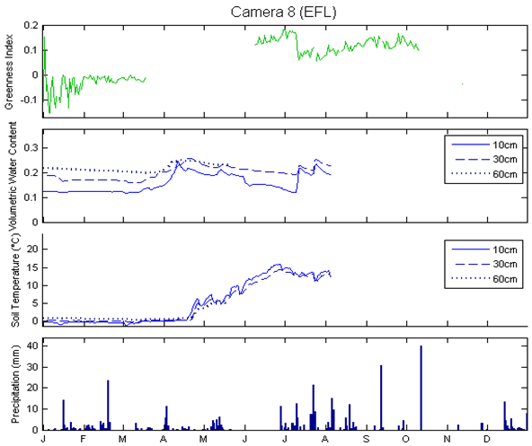
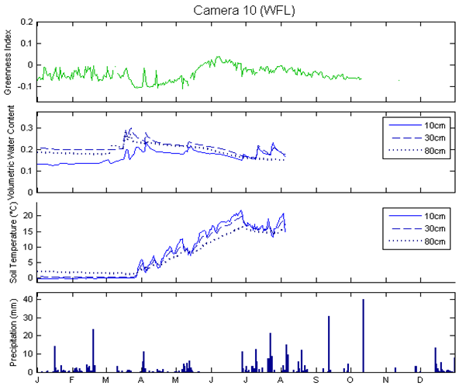
Results
East Facing – High Elevation
West Facing – High Elevation
Greenness
All sites got moisture from snowmelt
Soil Moisture
Soil Temperature
Precipitation
Only lower sites got moisture from monsoon
East Facing – Low Elevation
West Facing – Low Elevation
Greenness appears to peak earlier at lower sites
Day of Year
Day of Year
Notes:
DON’T Mention Holes

Slide 9
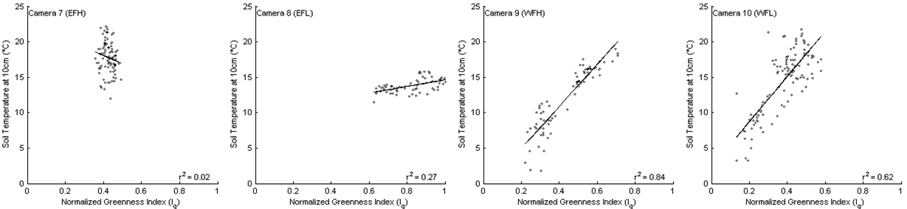
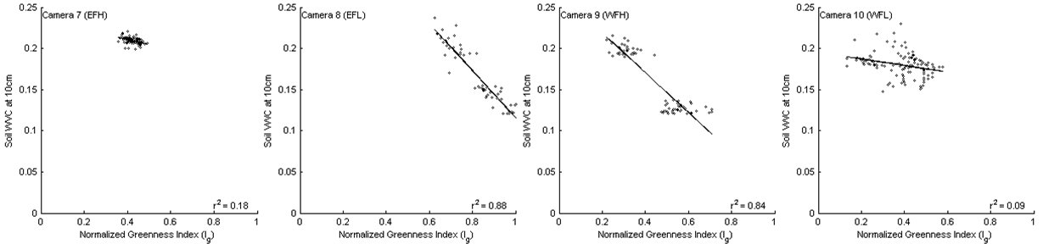
Results
East Facing – High
East Facing – Low
West Facing – High
West Facing – Low
10-cm Soil Temp
East Facing – High
East Facing – Low
West Facing – High
West Facing – Low
10-cm Soil Moisture
Normalized Greenness
West facing veg dynamics correlated with soil temperature
East facing high veg dynamics don’t appear to correlate with soil temperature or moisture

Slide 10
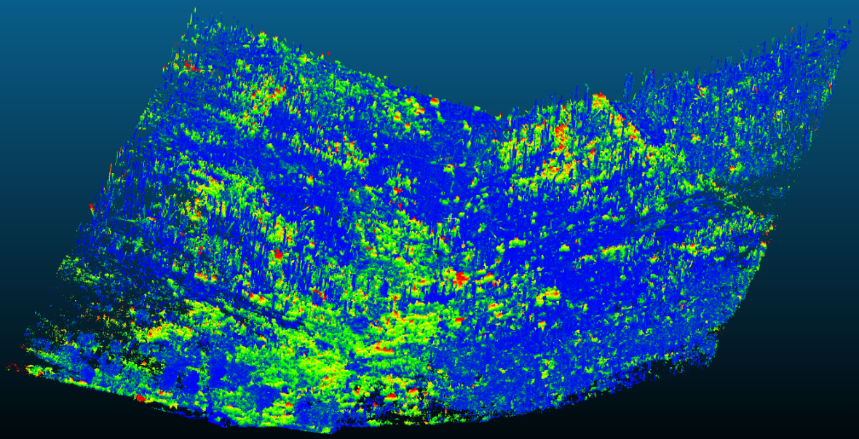
Results
Difference between two
Scans: 9/25/11 and
9/25/12
Vegetation dynamics appear different when considered on a larger scale.
Vegetation appears to be more successful at the point of convergence, especially lower in the watershed.
West-facing aspect appears to be more successful than east-facing.

Slide 11
Take Home Points
Vegetation recovery was not uniform across the watersheds
Future forest structure may ultimately be triggered by differences in soil moisture and temperature
Slower post burn recovery of vegetation near the top of the watersheds will have consequences for ecosystem services, such as erosion and downstream deposition control
LiDAR and phenocams are valuable watershed management tools allowing analysis across very fine spatial and temporal scales
Notes:
Greenness at high elevation east facing sites did not appear to be either temperature or moisture controlled
These were also the sites where aspen were not found in the phenocam images
Overall east facing and lower elevation sites had the most difficulty with any vegetation recovery.

Slide 12
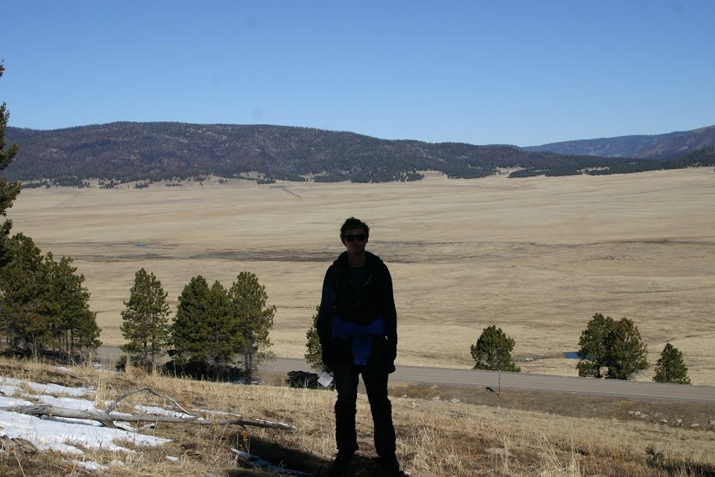


Thank You!
Questions?

